Slide 1

Sterling E-Commerce Data Analysis Report
Data Scientist :
Ndumbi Kimani

Slide 2
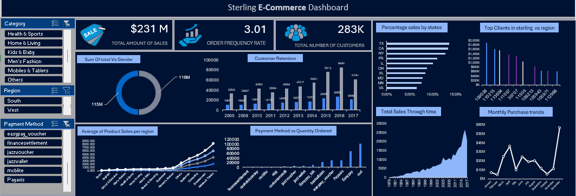
Project Title: Sterling E-Commerce
INTERACTIVE DASHBOARD

Slide 3
Project Title: Sterling E-Commerce
Objectives
INTRODUCTION
The analysis provided key insights into the performance and trends of Sterling E-Commerce. By addressing the recommendations, the company can enhance its operations, improve customer satisfaction, and boost overall sales performance.
AIM AND OBJECTIVES
Understanding the Business Goals
METHODOLOGY
The primary objective of this analysis was to gain insights into customer behavior, preferences, and trends to optimize product offerings, streamline operations, and enhance the overall customer experience. By analyzing sales data, geographic distribution, payment methods, and customer demographics, the goal was to identify key areas for improvement and strategic opportunities.
ANALYSIS
RECOMMENDATION
CONCLUSION

Slide 4
Project Title: Sterling E-Commerce
Data Preparation Process
INTRODUCTION
- Duplicate Checking: Used unique functions to identify and remove duplicate entries in the dataset.
- Date Trimming: Adjusted date formats for consistency and ease of analysis.
- Month Extraction: Employed the `IFS` function to extract and categorize data by months for seasonal analysis
AIM AND OBJECTIVES
METHODOLOGY
Data Aggregation
ANALYSIS
The team aggregated the data into four primary insights:
- Customer Insights: Analysed data based on gender.
- Sales Data: Evaluated total sales figures.
- Geographic Distribution: Assessed sales across different states.
- Operational Insights: Examined payment methods used by customers.
Pivot tables, charts, and slicers were created for interactive control and deeper insights
RECOMMENDATION
CONCLUSION

Slide 5
Project Title: Sterling E-Commerce
INTRODUCTION
Sales Performance
Overall Sales: The company has a robust sales performance with a frequency rate of 3.21 and a total customer base of 283,000.
Regional Sales
Top Performing State: Texas leads in sales among all states.
Peak Year: 2017 was the highest-grossing year.
Regional Insights: The South region dominates sales with $90 million, holding the highest average sales among all regions (Northwest, South, West, and Midwest).
Seasonal Trends
Lowest Sales Month: January.
Peak sales month: December, followed closely by April and July.
Top Selling Category.
Books: Consistently the top-selling category in terms of sales volume over time
Payment Methods
Preferred Methods: Cash on Delivery (COD) is the most preferred, followed by Easy Pay.
Least Used Method: "Financial settlement" is the least utilized and may not be cost-effective.
AIM AND OBJECTIVES
METHODOLOGY
ANALYSIS
RECOMMENDATION
CONCLUSION

Slide 6
Project Title: Sterling E-Commerce
Continuation…
INTRODUCTION
AIM AND OBJECTIVES
Gender Analysis
Balanced Interest: Products in the styling category appeal equally to both genders.
Women's Fashion: Shows consistent popularity throughout the year.
Customer Retention
Lowest Retention: Health and sports category, indicating a need for targeted retention strategies
Gender Distribution Across Categories
Male-dominated categories: Books, health, sports, and school and education.
Balanced Categories: Other categories show a more balanced gender distribution.
Order Frequency Rate
The highest order frequency rate is in the Entertainment category with a 2.01 frequency rate.
Top Category: Mobile phones and tablets, with 61,000 purchases.
METHODOLOGY
ANALYSIS
RECOMMENDATION
CONCLUSION

Slide 7
Project Title: Sterling E-Commerce
INTRODUCTION
1. Inventory Management:
Prepare inventory for the peak sales month of December.
Plan inventory according to seasonal trends
2. Payment Method Optimization:
Anticipate the preferred payment methods during high-traffic periods.
3. Customer Loyalty Programs:
Implement loyalty programs to enhance customer retention, especially in categories with low retention rates.
4. Promotional Strategies:
Promote merchandise strategically during low and high-selling months.
Use discount sales and increased advertising
5. Geographic Marketing:
Ensure fair and tailored strategic marketing across all states.
Focus on low-selling and high-selling states specifically.
6. Feedback Mechanism:
Establish a feedback system on the website and online platforms to encourage customer feedback and improve service.
AIM AND OBJECTIVES
METHODOLOGY
ANALYSIS
RECOMMENDATION
CONCLUSION

Slide 8
CONCLUSION
Thank you

